Slide 1
Clustered Systems

Slide 2
A clustered system is a type of multiprocessor system, which gathers together multiple CPUs.
Clustered systems differ from the multiprocessor systems in that they are composed of two or more individual systems—or nodes—joined together; each node is typically a multicore system.
Clustered computers share storage and are closely linked via a local-area network LAN or a faster interconnect, such as InfiniBand.
Clustering is usually used to provide high-availability service.
A layer of cluster software runs on the cluster nodes. Each node can monitor one or more of the others (over the network).

Slide 3
CLUSTERING STRUCTURE
In asymmetric clustering, one machine is in hot-standby mode while the other is running the applications
In symmetric clustering, two or more hosts are running applications and are monitoring each other. This structure is obviously more efficient, as it uses all of the available hardware.

Slide 4
Shared Access in a cluster
Each machine has full access to all data in the database.
The system must also supply access control and locking to ensure that no conflicting operations occur. This function, commonly known as a distributed lock manager (DLM), is included in some cluster technology. DLM is a traffic controller.
Cluster technology is changing rapidly. Some cluster products support thousands of systems in a cluster, as well as clustered nodes that are separated by miles.
Many of these improvements are made possible by storage-area networks (SANs), which allow many systems to attach to a pool of storage.

Slide 5
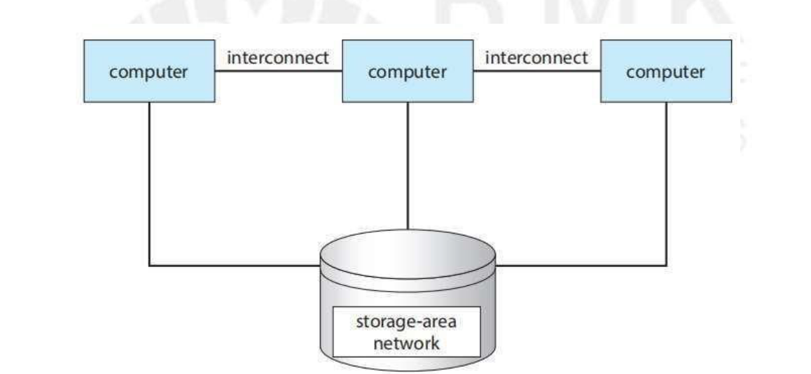

Slide 6
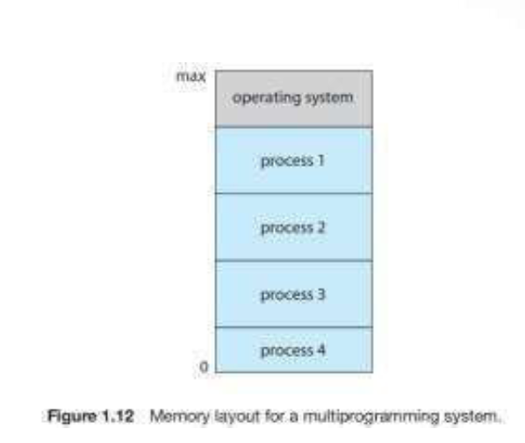
Multiprogrammed system
In a multiprogrammed system, a program in execution is termed a process. The operating system keeps several processes in memory simultaneously.
The operating system picks and begins to execute one of these processes. Eventually, the process may have to wait for some task, such as an I/O operation, to complete.

Slide 7
Dual-Mode and Multimode Operation
In order to ensure the proper execution of the operating system.
There are two separate modes of operation: user mode and kernel mode (also called supervisor mode, system mode, or privileged mode). A bit, called the mode bit, is added to the hardware of the computer to indicate the current mode: kernel (0) or user (1).
At system boot time, the hardware starts in kernel mode. The operating system is then loaded and starts user applications in user mode.

Slide 8
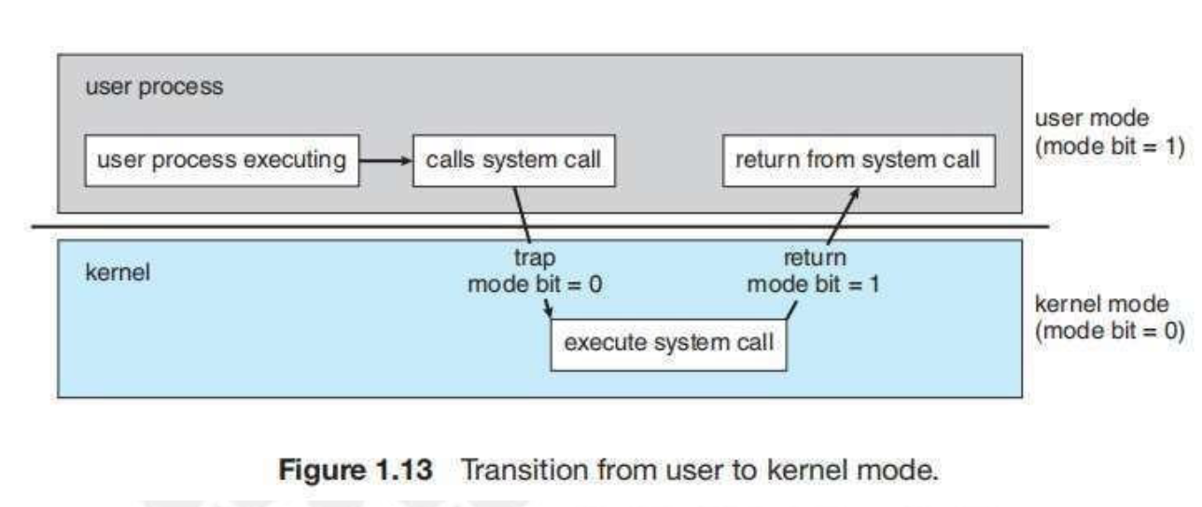
However, when a user application requests a service from the operating system (via a system call), the system must transition from user to kernel mode to fulfill the request.

Slide 9
The dual mode of operation provides us with the means for protecting the operating system from errant users.
The hardware allows privileged instructions to be executed only in kernel mode.
The instruction to switch to kernel mode is an example of a privileged instruction. Some other examples include I/O control, timer management, and interrupt management.
CPUs that support virtualization frequently have a separate mode to indicate when the virtual machine manager (VMM)—and the virtualization management software—is in control of the system. In this mode, the VMM has more privileges than user processes but fewer than the kernel

Slide 10
TIMER
Operating system maintains control over the CPU.
We cannot allow a user program to get stuck in an infinite loop or to fail to call system services and never return control to the operating system. To accomplish this goal, we can use a timer.
A timer can be set to interrupt the computer after a specified period. The period may be fixed (for example, 1/60 second) or variable (for example, from 1 millisecond to 1 second).
A variable timer is generally implemented by a fixed-rate clock and a counter. The operating system sets the counter. Every time the clock ticks, the counter is decremented. When the counter reaches 0, an interrupt occur.

